Slide 1
Optimizing PageSpeed for WordPress

Slide 2
Fahad Sheikh

Slide 3
Does it really matter?

Slide 4
What we deliver
10
Seconds to fully load a website with all visual and below the fold content
22
Seconds to fully load a website on mobile devices
70%
70% of the web pages on the internet are over 1MB

Slide 5
What people expect
47%
Expect a web page to load in two seconds or less.
64%
Expect a page to load in less than 4 seconds on mobile devices
79%
Who are dissatisfied by site performance are less likely to buy again

Slide 6
Google
Through a survey Google found out people want 30 results per page instead of 20.
Google changed some search result pages to 30 results per page.
Pages that displayed 30 results each had traffic to them drop down to an astounding 20%
The Page Speed difference between 30 and 20 results per page was just half a second

Slide 7
Mozilla
Mozilla Found out Chrome’s download page is much faster.
Mozilla shaved 2.2 seconds off the average page load time
Which increased download conversions by 15.4%!
With 27.5 daily visitors, this improvement translated to 10.28 million additional downloads per year

Slide 8
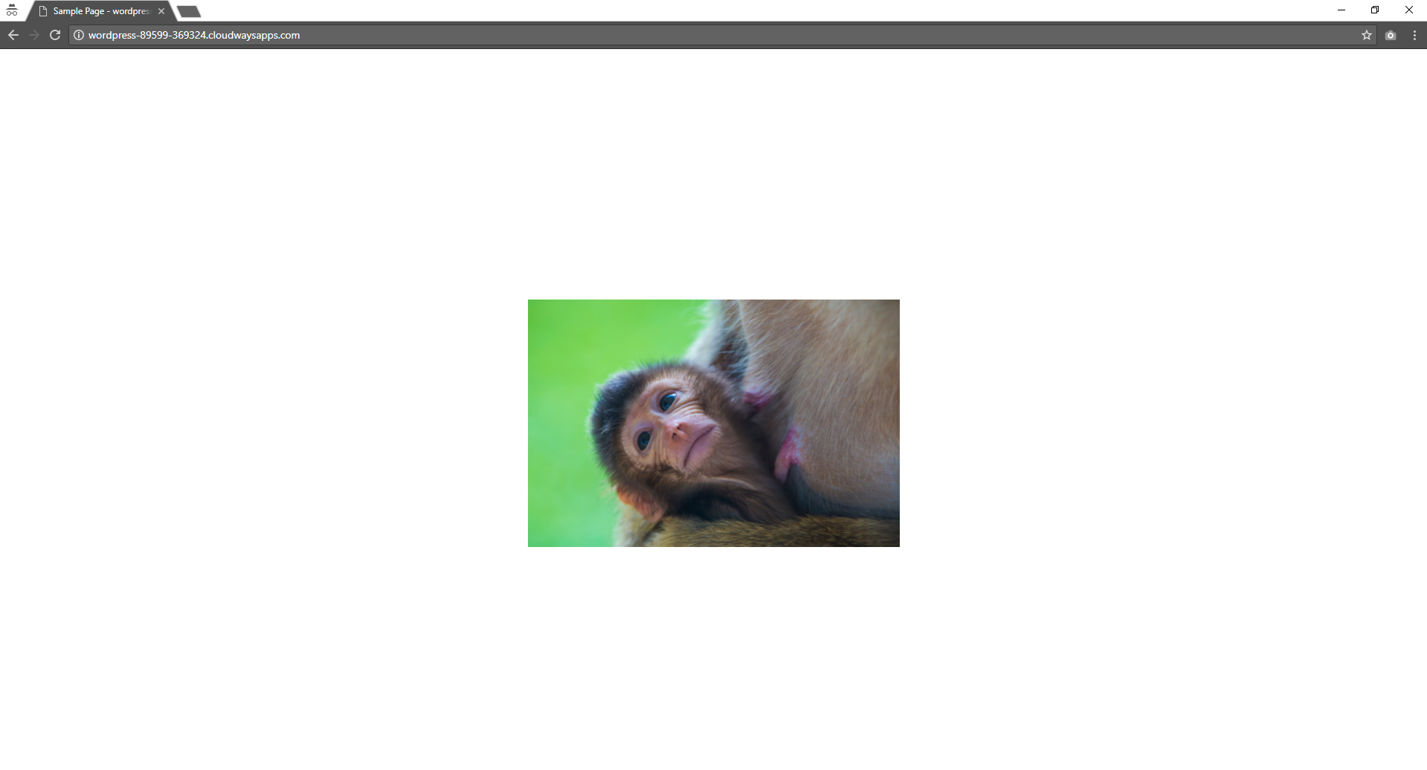
I made a website and did everything wrong to test things out

Slide 9
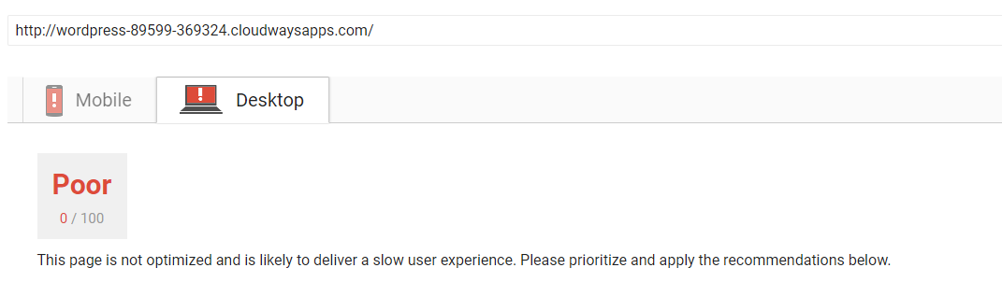
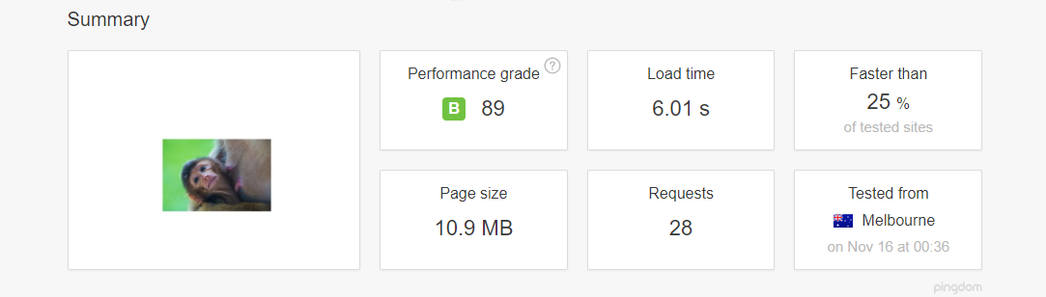
PageSpeed Results
Google
Pingdom

Slide 10
Page Speed Essentials
Caching
Image Optimization
Asset Minification and Compression
Eliminate Render Blocking JS
You can’t get away with cute monkeys

Slide 11
What is Caching?
1500 * 35 = 52500

Slide 12
Caching
Does your webhost provide server-side caching? (Varnish, nginx)
Use a WordPress Caching Plugin. (WP Super Cache, W3 Total Cache)
Never use two caching plugins.
Using both server-side and a WordPress plugin for caching is not necessary

Slide 13
Image Optimization
Image Compression (tinyjpg.com, compressor.io, WP Smush)
Image Resizing (Any Image Editing Tool)
When developing your themes use add_image_size for fixed width images

Slide 14
Asset Minification and Compression
Minify your HTML, CSS and Javascript files (Autoptimize, WP Super Cache)
Leverage Browser Caching by providing Header Expiry Dates. (Attached in shared git repo)
Javascript Minification might break your site
Enable gzip compression. (Attached in shared git repo)

Slide 15
Eliminate Render Blocking JS
What is Render Blocking?
Load all JS files in your footer
Try to limit plugins to their specific pages
Use async where you can.
Don’t use async on scripts that are dependent on page load

Slide 16
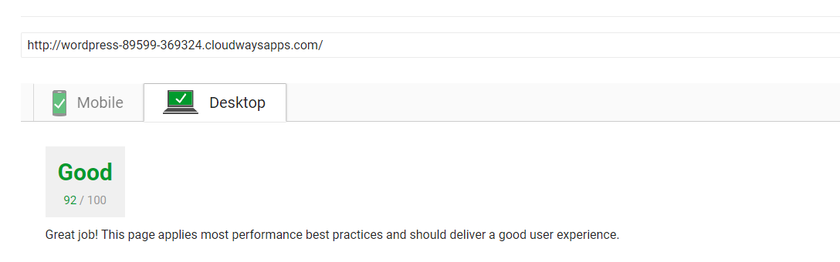
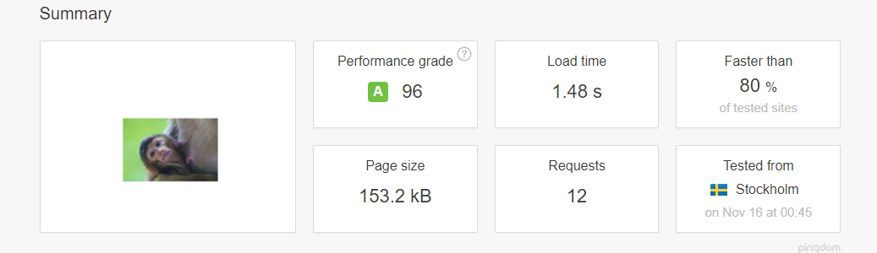
After Optimization
Google
Pingdom

Slide 17
All in one tools to try out
Gulp
Google’s PageSpeed Module

Slide 18
References
Facts
https://www.akamai.com/us/en/about/news/press/2009-press/akamai-reveals-2-seconds-as-the-new-threshold-of-acceptability-for-ecommerce-web-page-response-times.jsp
https://www.dynatrace.com/blog/web-performance-and-mobile-site-performance-optimization-using-page-speed/
https://blog.mozilla.org/metrics/2010/04/05/firefox-page-load-speed-%E2%80%93-part-ii/
https://blog.kissmetrics.com/speed-is-a-killer/
https://www.thinkwithgoogle.com/marketing-resources/data-measurement/mobile-page-speed-new-industry-benchmarks/
Guides
https://gtmetrix.com/add-expires-headers.html
https://gtmetrix.com/enable-gzip-compression.html
https://matthewhorne.me/defer-async-wordpress-scripts/
https://gtmetrix.com/add-expires-headers.html
https://gtmetrix.com/enable-gzip-compression.html
https://matthewhorne.me/defer-async-wordpress-scripts/
https://css-tricks.com/gulp-for-beginners/
https://understrap.com/
Worth a Read
https://webmasters.googleblog.com/2010/04/using-site-speed-in-web-search-ranking.html
https://engineering.instagram.com/performance-usage-at-instagram-d2ba0347e442
https://www.youtube.com/watch?v=ai-6qwT6ES8&feature=youtu.be&t=462
https://edge.akamai.com/ec/us/highlights/keynote-speakers.jsp#edge2016futureofcommercemodal

Slide 19
Thankyou!
Github: /fahaadsheikh
Facebook: /fahaddsheikh

